Slide 1
The HER process in (Eletro)catalysis

Slide 2
Background
Well-known Works
Detailed Part

Slide 3
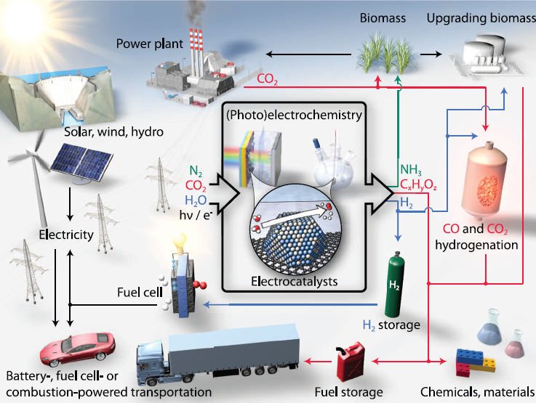
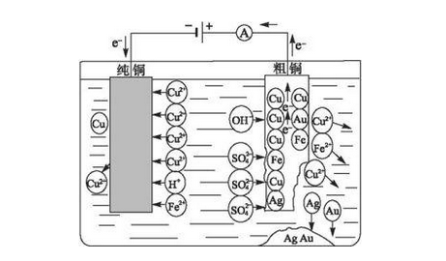
Electrolytic Cell
Heterogeneous catalysis
Homogeneous catalysis

Slide 4
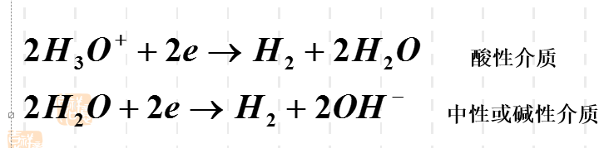
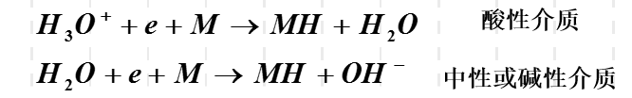
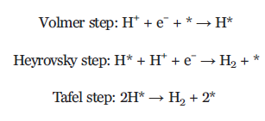

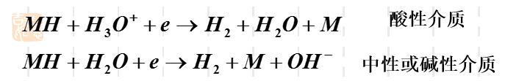
Hydrogen Evolved Reaction:
Adsorber-reduction Process
Compound-desorption Process
EC-desorption Process
Z. W. Seh et al., Science, 355 (2017)

Slide 5
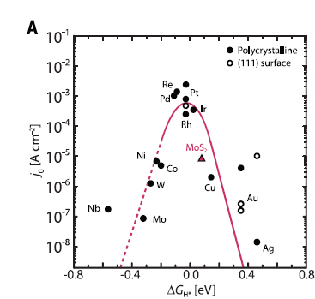
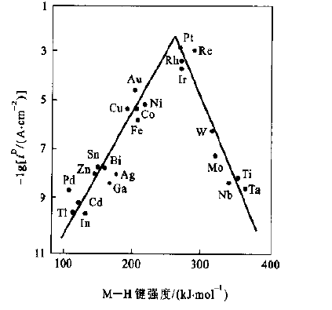
Some Electro materials:
Z. W. Seh et al., Science, 355 (2017)

Slide 6
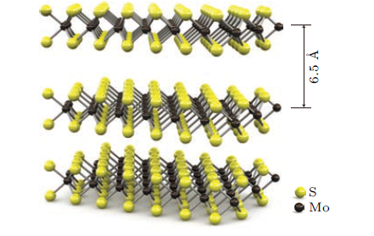
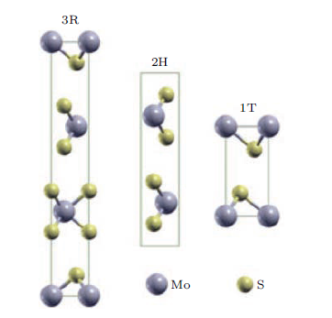
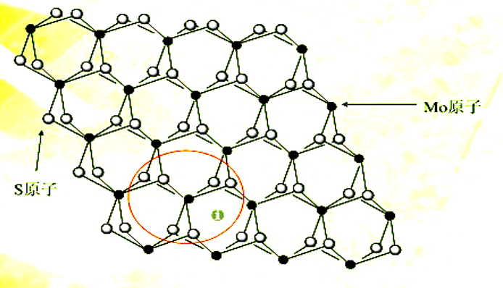
The structure of MoS₂

Slide 7
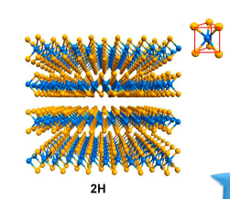
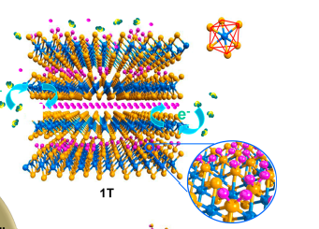
Flexible Device
Corrosion Protection
FET
Electrode Material
Catalysis
LED
Adsorbent
Y. Yin, J. Han, et al., J Am Chem Soc,7965-72 (2016)

Slide 8
2.Well-known Works

Slide 9
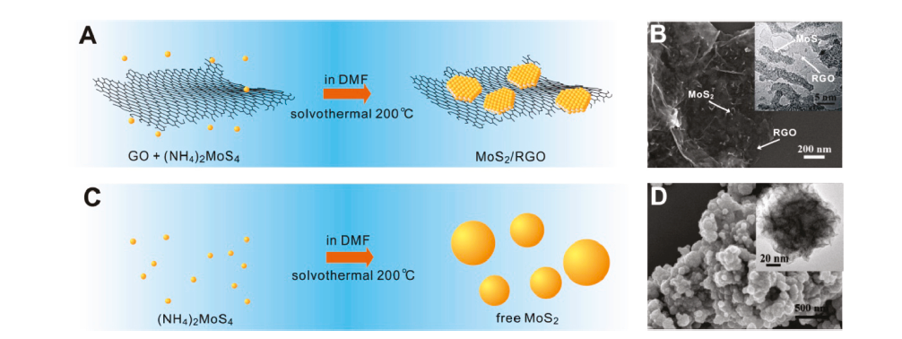
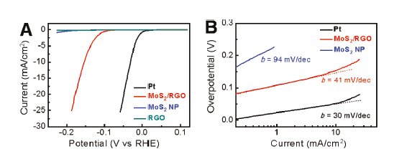
Y. Li, et al., J Am Chem Soc, 7296-9(2011)

Slide 10
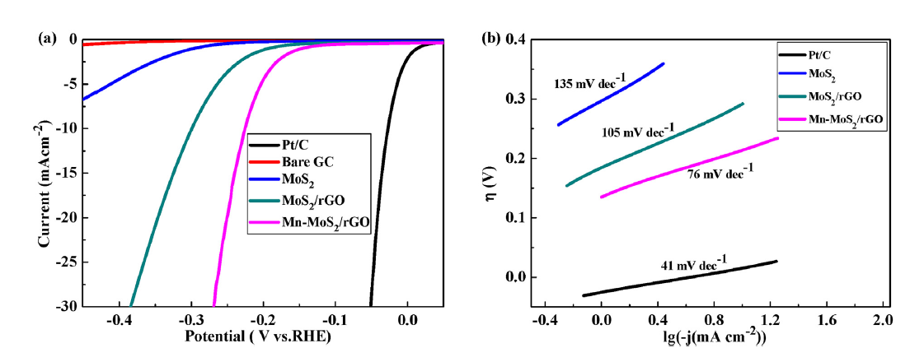
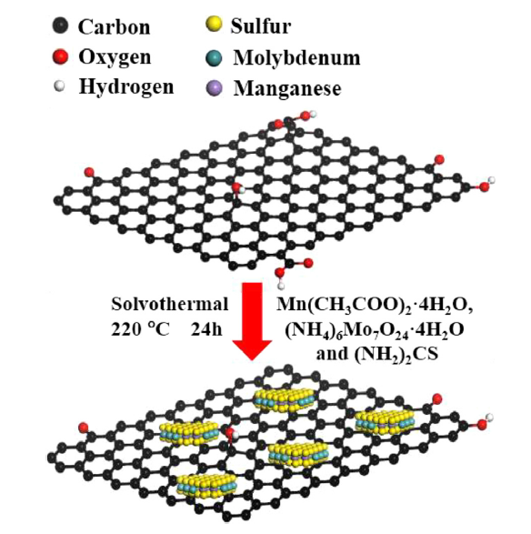
L. Wu, et al., Applied Surface Science, 470-477 (2017)

Slide 11
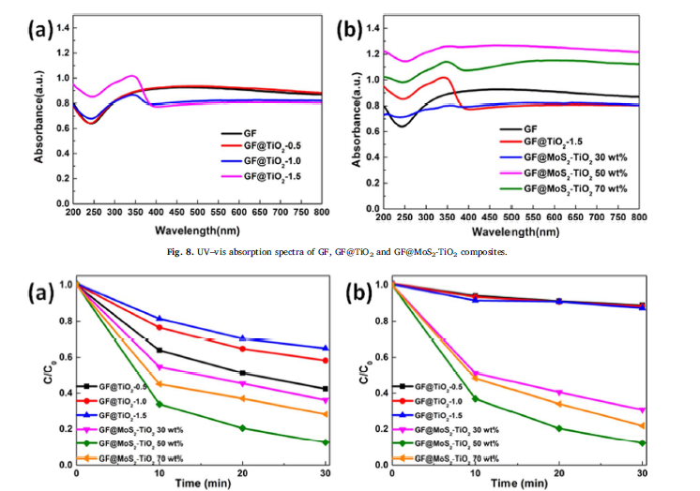
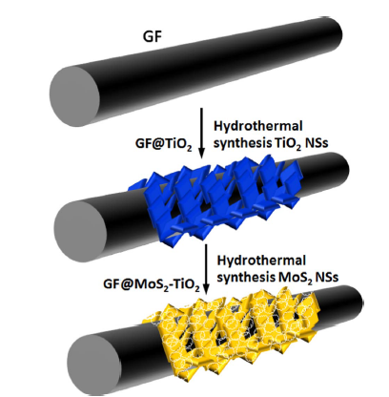
Composite Material For Photocatalysis
X. Hu, et al., “Solar Energy Materials and Solar Cells, 108-116 (2017)

Slide 12
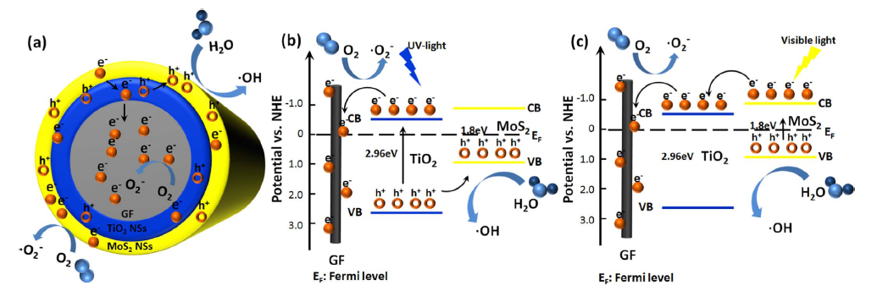

Slide 13
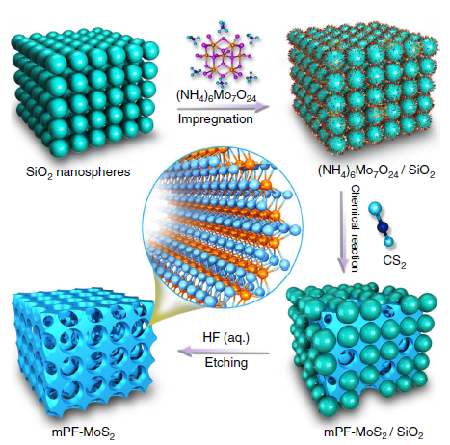
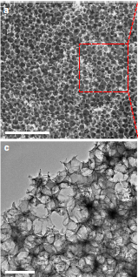
J. Deng, et al., Nat Commun, 14430 (2017)

Slide 14
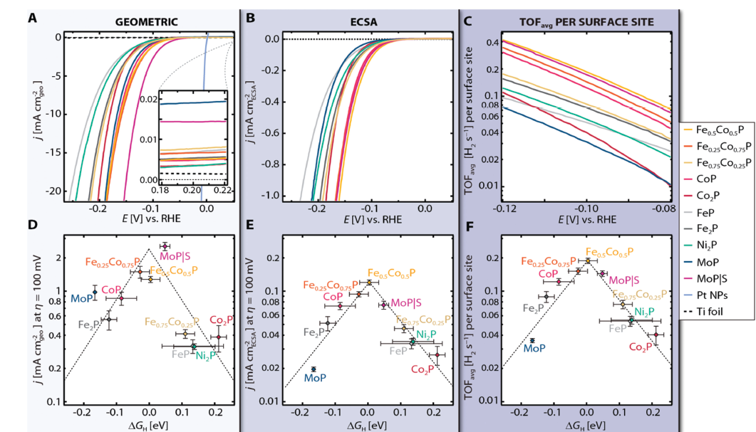
And TMPs
J. Kibsgaard, et al., Energy & Environmental Science ,3022-3029 (2015)

Slide 15
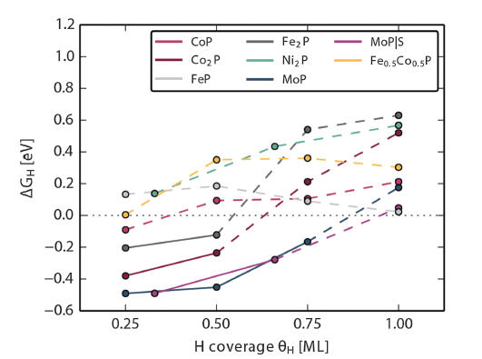
Solid Line & Dashed Line
Descriptor
FeP(Need Further Reasch)

Slide 16
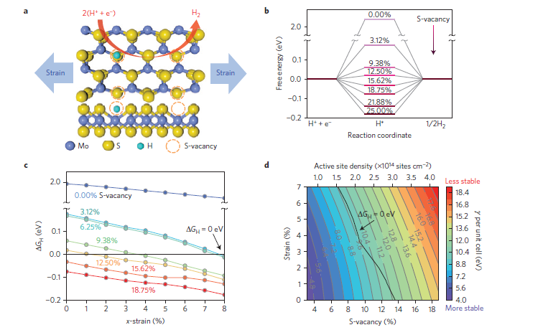
S-vacancies & Strain (by DFT)
H. Li, et al., Nat Mater, 364 (2016)

Slide 17
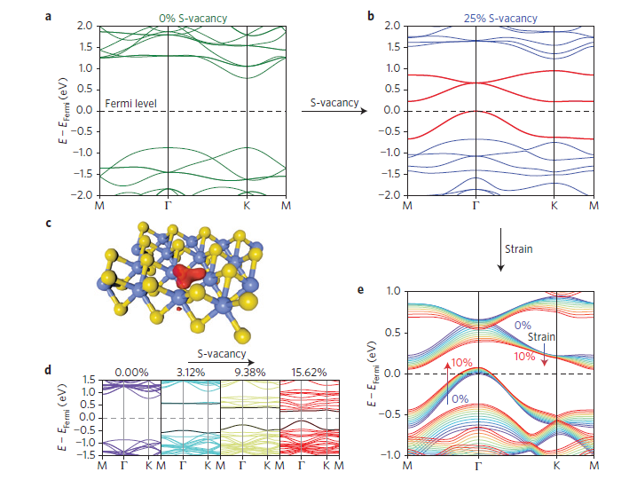
H. Li, et al., Nat Mater, 364 (2016)

Slide 18
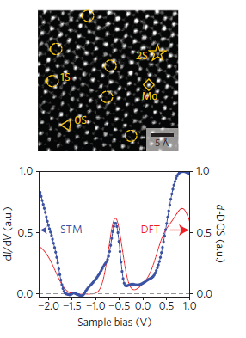
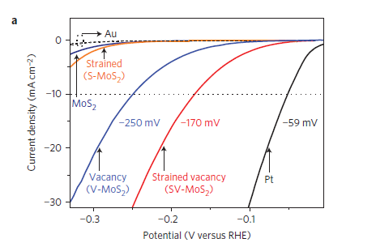
H. Li, et al., Nat Mater, 364 (2016)

Slide 19
3.Detailed Part

Slide 20
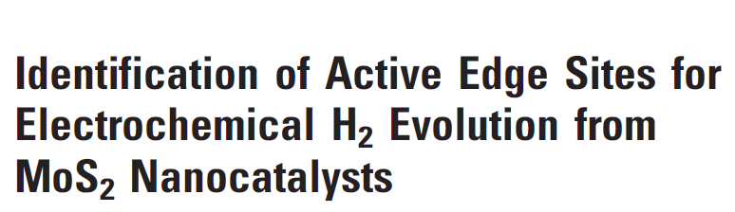
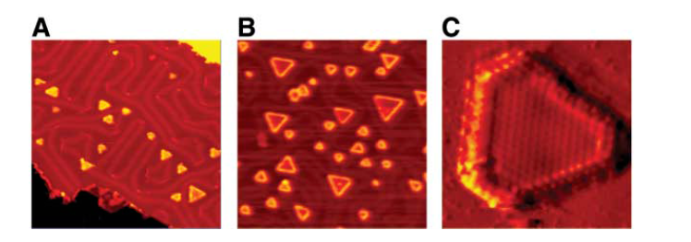
47nm X 47 nm
6% coverage Rating
400°
23% coverage Rating
550°
F. Thomas et al., Science, 317 (2007)

Slide 21
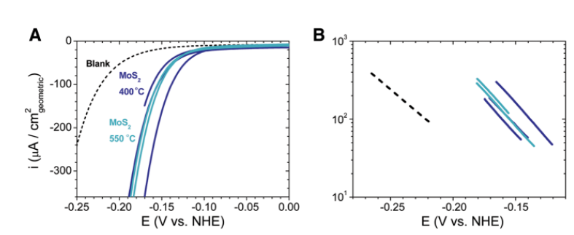
Polarization Curve & Tafel Slope
Irrespective of annealing T and coverage

Slide 22
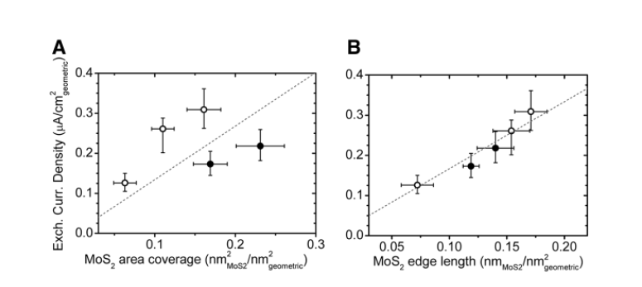
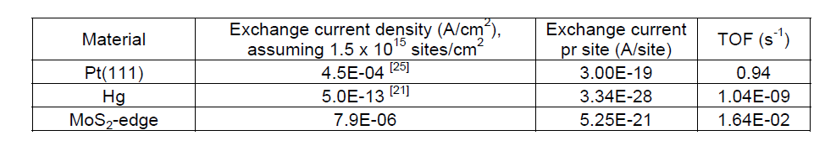
Versus MoS₂ coverage edge length
Filled circles 550°C
Open circles 400°C

Slide 23
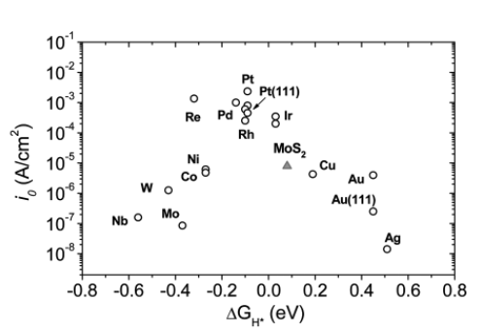
MoS₂ 1.5*10¹⁵ site/cm²
7.9*10⁻⁶ A/cm²
Volcano Plot （by DFT）

Slide 24
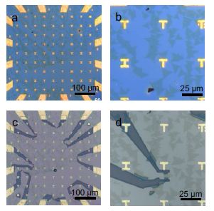
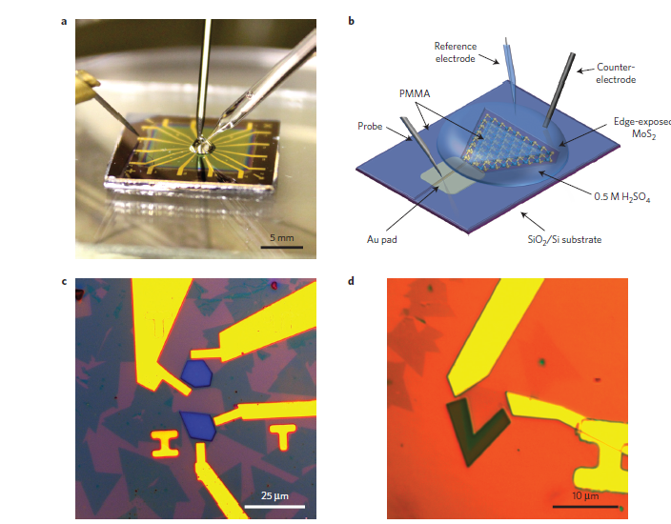
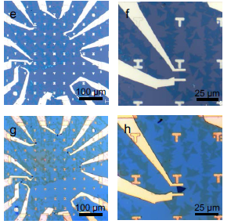
Electroinic coupling between sub and TMD
D. Voiry, et al., Nat Mater, 1003-9(2016)

Slide 25
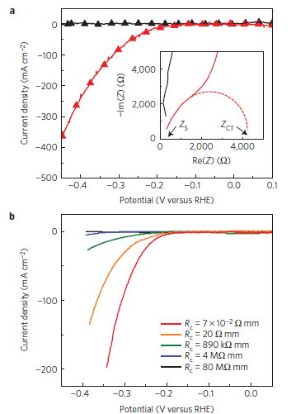
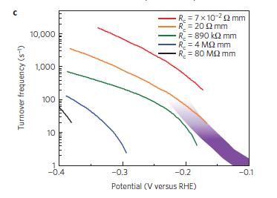

Slide 26
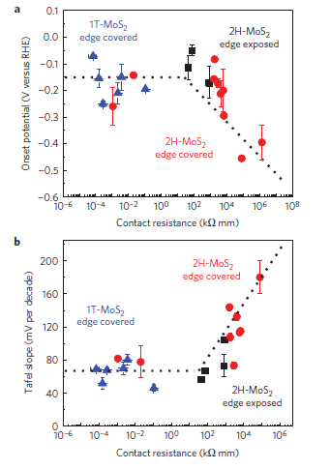
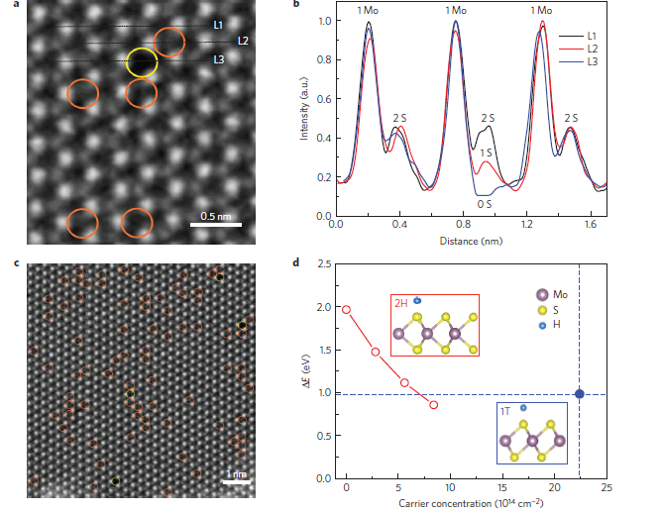

Slide 27
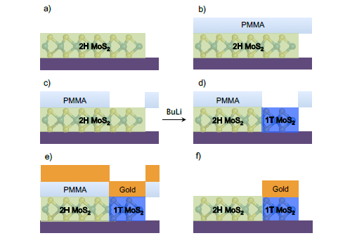
Intercalation

Slide 28
THANKS

